Slide 1
16CSE09 / Machine Learning Techniques
Unit - 3
Topic: Steps in MLT Process

Slide 2
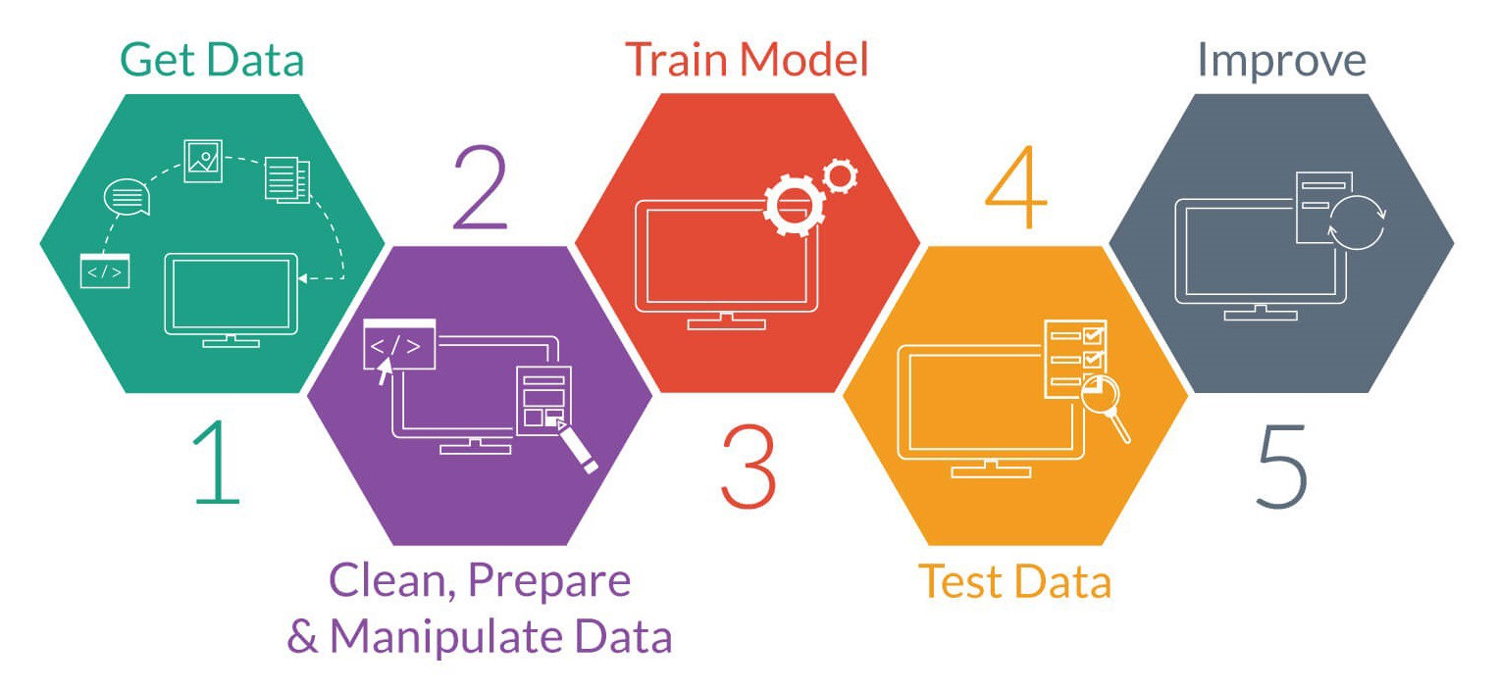
F

Slide 3
The 7 Steps of Machine Learning
1 - Data Collection
2 - Data Preparation
3 - Choose a Model
4 - Train the Model
5 - Evaluate the Model
6 - Parameter Tuning
7 - Make Predictions

Slide 4
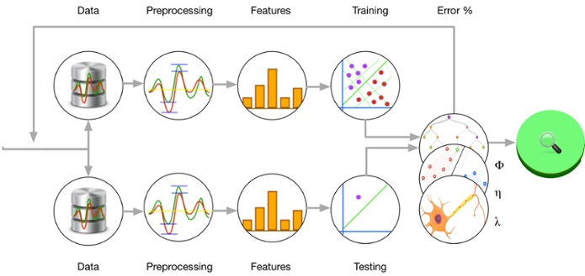
Steps of Machine Learning

